Slide 1
NumaGiC:
A garbage collector for big-data on big NUMA machines
Lokesh Gidra‡, Gaël Thomas✵, Julien Sopena‡,
Marc Shapiro‡, Nhan Nguyen♀
‡ LIP6/UPMC-INRIA ✵Telecom SudParis ♀Chalmers University

Slide 2
Motivation
Data-intensive applications need large machines with plenty of cores and memory
Notes:
Require large memory for keeping data in-memory, and cores to compute that data

Slide 3
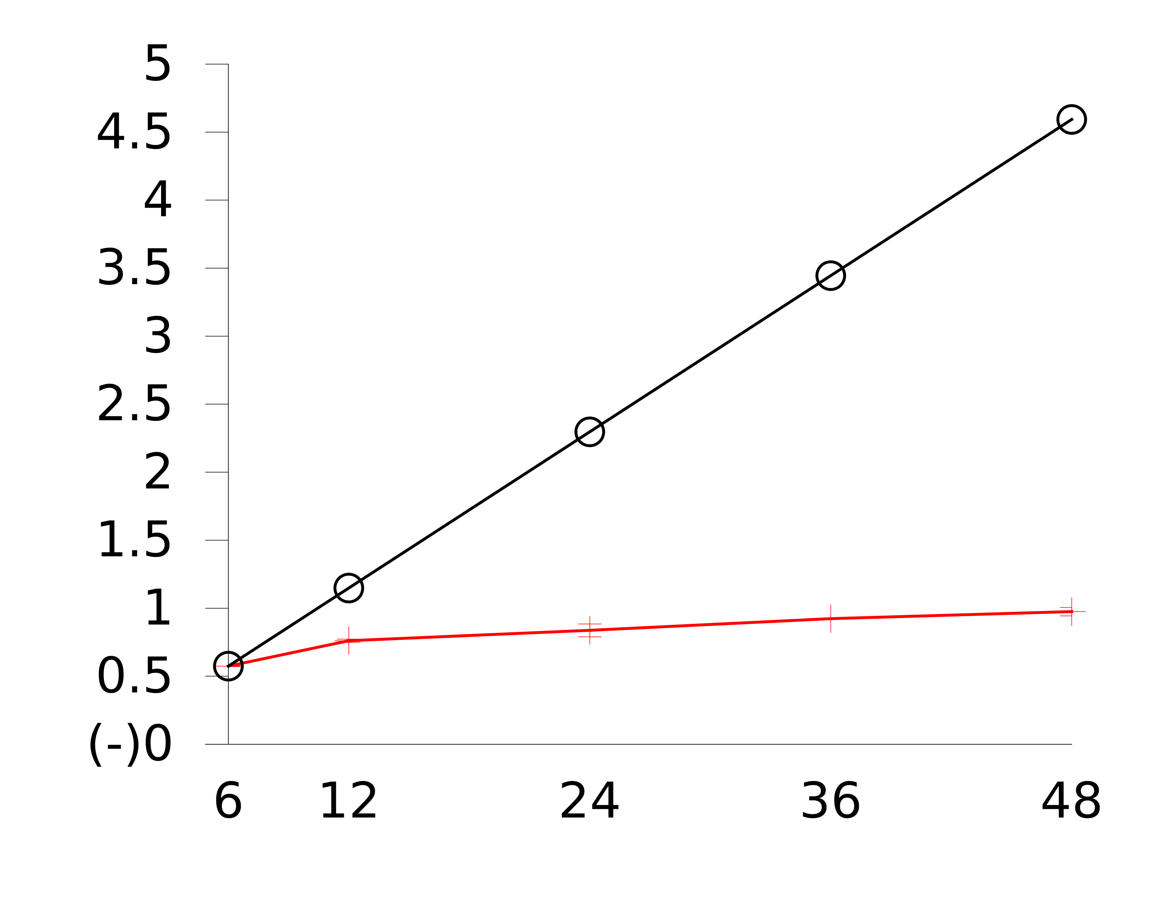
Motivation
Data-intensive applications need large machines with plenty of cores and memory
But, for large heaps, GC is inefficient on such machines
Ideal Scalability
GC Throughput
(GB collected per second)
Baseline PS
# of cores
Page rank computation of 100million edge Friendster dataset
with Spark on Hotspot/Parallel Scavenge with 40GB on a 48-core machine
Notes:
How well the application does, and found that GC scales very poorly on large heaps on large multicores
Why does GC performance matters? Should we really care about it?

Slide 4
Motivation
Data-intensive applications need large machines with plenty of cores and memory
But, for large heaps, GC is inefficient on such machines
Ideal Scalability
GC Throughput
(GB collected per second)
GC takes roughly 60% of the total time
Baseline PS
# of cores
Page rank computation of 100million edge Friendster dataset
with Spark on Hotspot/Parallel Scavenge with 40GB on a 48-core machine
Notes:
Yes, GC roughly takes 60% time
Means GC performance will have direct impact on app perf

Slide 5
Outline
Why GC doesn’t scale?
Our Solution: NumaGiC
Evaluation

Slide 6
GCs don’t scale because machines are NUMA
Hardware hides the distributed memory
⇒ application silently creates inter-node references
Node 0
Node 1
Memory
Memory
Memory
Memory
Node 2
Node 3
Notes:
Explain what is NUMA machine
Kind of a network of nodes, but with automatic consistency hence hiding distributed nature of memory

Slide 7
GCs don’t scale because machines are NUMA
But memory distribution is also hidden to the GC threads
when they traverse the object graph
GC thread
Node 0
Node 1
Memory
Memory
Memory
Memory
Node 2
Node 3
Notes:
First explain what is a GC explain "Object graph in which object == node, references == edge"

Slide 8
GCs don’t scale because machines are NUMA
But memory distribution is also hidden to the GC threads
when they traverse the object graph
GC thread
Node 0
Node 1
Memory
Memory
Memory
Memory
Node 2
Node 3

Slide 9
GCs don’t scale because machines are NUMA
A GC thread thus silently traverses remote references
GC thread
Node 0
Node 1
Memory
Memory
Memory
Memory
Node 2
Node 3

Slide 10
GCs don’t scale because machines are NUMA
A GC thread thus silently traverses remote references
and continues its graph traversal on any node
GC thread
Node 0
Node 1
Memory
Memory
Memory
Memory
Node 2
Node 3

Slide 11
GCs don’t scale because machines are NUMA
A GC thread thus silently traverses remote references
and continues its graph traversal on any node
GC thread
Node 0
Node 1
Memory
Memory
Memory
Memory
Node 2
Node 3
Notes:
And imagine what would happen when GC threads are running on all the nodes, and they all do remote access at the same time?

Slide 12
GCs don’t scale because machines are NUMA
When all GC threads access any memory nodes,
the inter-connect potentially saturates
=> high memory access latency
Node 0
Node 1
Memory
Memory
Memory
Memory
Node 2
Node 3
Notes:
It could potentially saturate the inter-connect. Leading to very high memory access latencies

Slide 13
Outline
Why GC doesn’t scale?
Our Solution: NumaGiC
Evaluation

Slide 14
How can we fix the memory locality issue?
Simply by preventing any remote memory access
Notes:
How can we fix the remote access problem? Simple, but not doing so ☺

Slide 15
Prevent remote access using messages
Enforces memory access locality
by trading remote memory accesses by messages
Node 0
Node 1
Memory
Memory
Thread 0
Thread 1
Notes:
we ensure local access, but using messages.
As long objects are on local node, no issues. Keep traversing as usual

Slide 16
Prevent remote access using messages
Enforces memory access locality
by trading remote memory accesses by messages
Node 0
Node 1
Memory
Memory
Thread 0
Thread 1

Slide 17
Prevent remote access using messages
Enforces memory access locality
by trading remote memory accesses by messages
Node 0
Node 1
Memory
Memory
Thread 0
Thread 1
Remote reference ⇒ sends it to its home-node
Notes:
When the thread discovers a remote ref, don’t process it, but rather send it as a message to the node where the associated obj belongs

Slide 18
Prevent remote access using messages
Enforces memory access locality
by trading remote memory accesses by messages
Node 0
Node 1
Memory
Memory
Thread 0
Thread 1
Remote reference ⇒ sends it to its home-node
Notes:
So that eventually a GC thread running on that node receives the msg

Slide 19
Prevent remote access using messages
Enforces memory access locality
by trading remote memory accesses by messages
Node 0
Node 1
Memory
Memory
Thread 0
Thread 1
And continue the graph traversal locally
Notes:
And processes the object associated with the reference in the received msg locally

Slide 20
Prevent remote access using messages
Enforces memory access locality
by trading remote memory accesses by messages
Node 0
Node 1
Memory
Memory
Thread 0
Thread 1
And continue the graph traversal locally
Notes:
And continue processing the object graph as usual

Slide 21
Using messages enforces local access…
…but opens up other performance challenges
Notes:
We saw how simple and straight forward is the idea of using message to enforce locality. However, there are performance challenges that it opens up

Slide 22
Problem1: a msg is costlier than a remote access
Node 0
Node 1
Inter-node messages
must be minimized
Too many messages
Notes:
Cost of sending a message is considerably higher than a single remote access, so it is essential to amortize the cost of sending a msg
Of course we gather a bunch of references before sending them, to ensure that size of a message is in multiples of cache line size
But to further amortize the cost, it is essential that there is a large enough sub-graph connected to the send reference’s obj that it makes sense to send the message
Msg for just a single object is simple too costly
Need to minimize the number of inter-node references, and hence msgs

Slide 23
Problem1: a msg is costlier than a remote access
Node 0
Node 1
Inter-node messages
must be minimized
Too many messages
Observation: app threads naturally create clusters of new allocated objs
99% of recently allocated objects are clustered
Notes:
Fortunately, we found that app threads create pretty good clusters of object allocated by them. And that there are very few references among these clusters

Slide 24
Problem1: a msg is costlier than a remote access
Node 0
Node 1
Inter-node messages
must be minimized
Too many messages
Observation: app threads naturally create clusters of new allocated objs
99% of recently allocated objects are clustered
Node 0
Node 1
Approach: let objects allocated by a thread stay on its node
Notes:
So our approach is to ensure that every app thread not only creates these objects local node, but also that the objects stay on the same node and doesn’t move to other nodes

Slide 25
Problem2: Limited parallelism
Due to serialized traversal of object clusters across nodes
Node 0
Node 1
Node 1 idles while node 0 collects its memory
Notes:
We just understood the benefit of good object clustering. However, it leads to a problem of “limited parallelism”. It takes place due to limited links between clusters ☺
Explain the figure

Slide 26
Problem2: Limited parallelism
Due to serialized traversal of object clusters across nodes
Solution: adaptive algorithm
  Trade-off between locality and parallelism
  Prevent remote access by using messages when not idling
  Steal and access remote objects otherwise
Node 0
Node 1
Node 1 idles while node 0 collects its memory
Notes:
We solve the issue by trading off locality for parallelism
We let the threads use messages when they are not idling
Otherwise, they globally steal objects from anywhere and processes, while also periodically checking if they can now move back to the local mode and be busy

Slide 27
Outline
Why GC doesn’t scale?
Our Solution: NumaGiC
Evaluation

Slide 28
Evaluation
Comparison of NumaGiC with –
  ParallelScavenge (PS): baseline stop-the-world GC of Hotspot
  Improved PS: PS with lock-free data structures and interleaved heap space
  NAPS: Improved PS + slightly better locality, but no messages
Metrics
  GC throughput –
    amount of live data collected per second (GB/s)
    Higher is better
  Application performance –
    Relative to improved PS
    Higher is better
Notes:
App performance is either in terms of completion time, or app throughput in bops/sec. we report app performance speedup relative to existing GCs. And so higher is better

Slide 29
Experiments
Name | Description | Heap Size
 |  | Amd48 | Intel80
Spark | In-memory data analytics (page rank computation) | 110 to 160GB | 250 to 350GB
Neo4j | Object graph database (Single Source Shortest Path) | 110 to 160GB | 250 to 350GB
SPECjbb2013 | Business-logic server | 24 to 40GB | 24 to 40GB
SPECjbb2005 | Business-logic server | 4 to 8GB | 8 to 12GB
1 billion edge Friendster dataset
The 1.8 billion edge Friendster dataset
Hardware settings –
  AMD Magny Cours with 8 nodes, 48 threads, 256 GB of RAM
  Xeon E7-2860 with 4 nodes, 80 threads, 512 GB of RAM

Slide 30



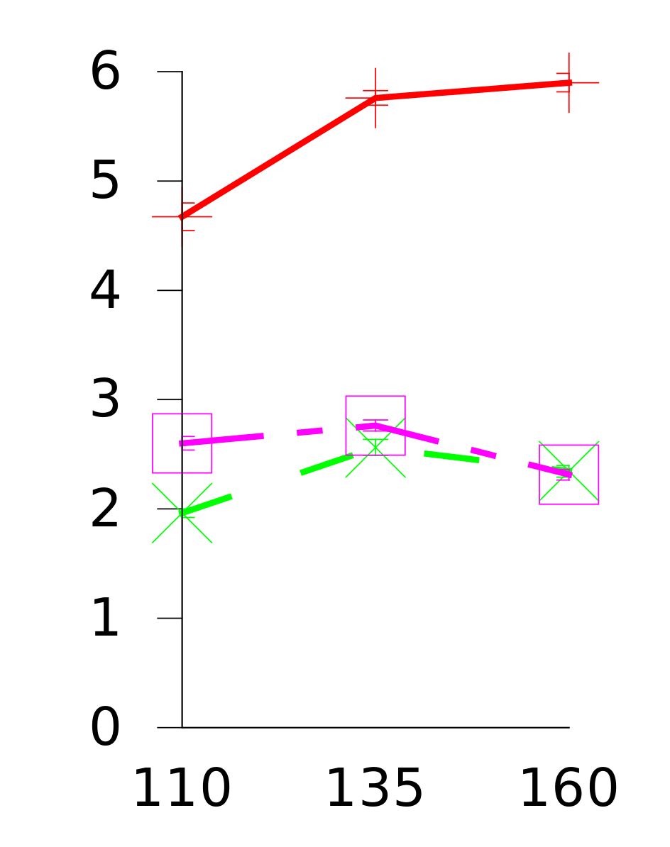
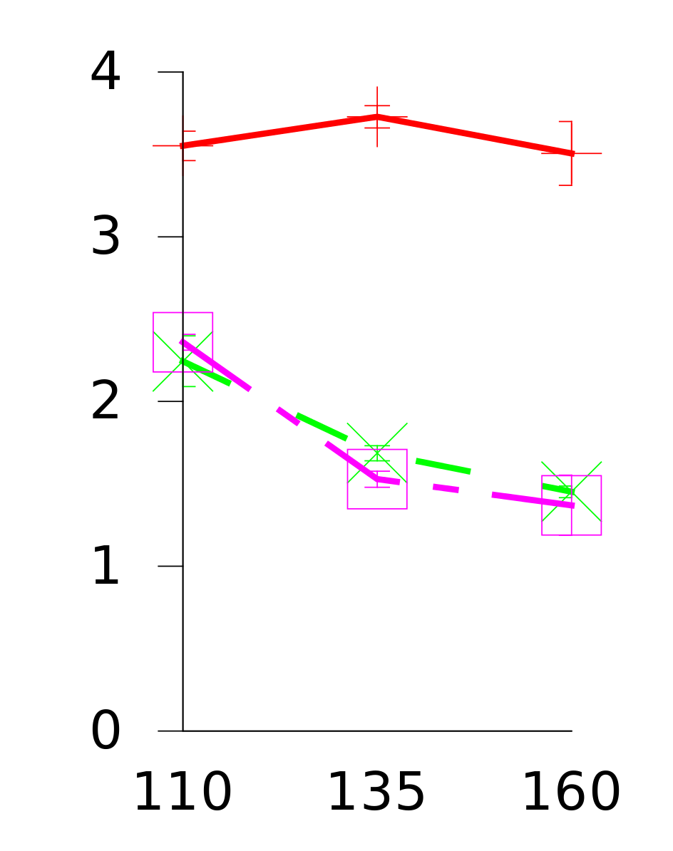
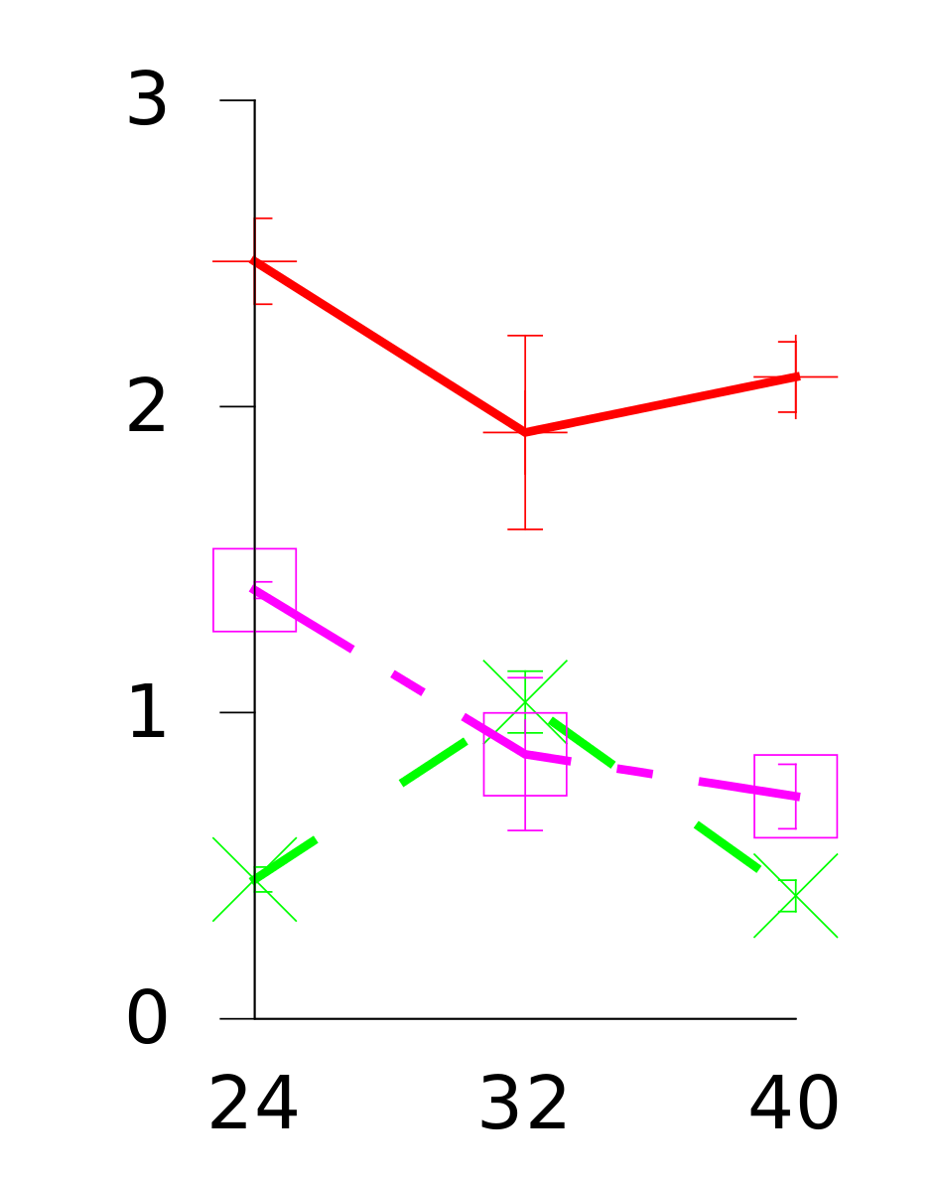
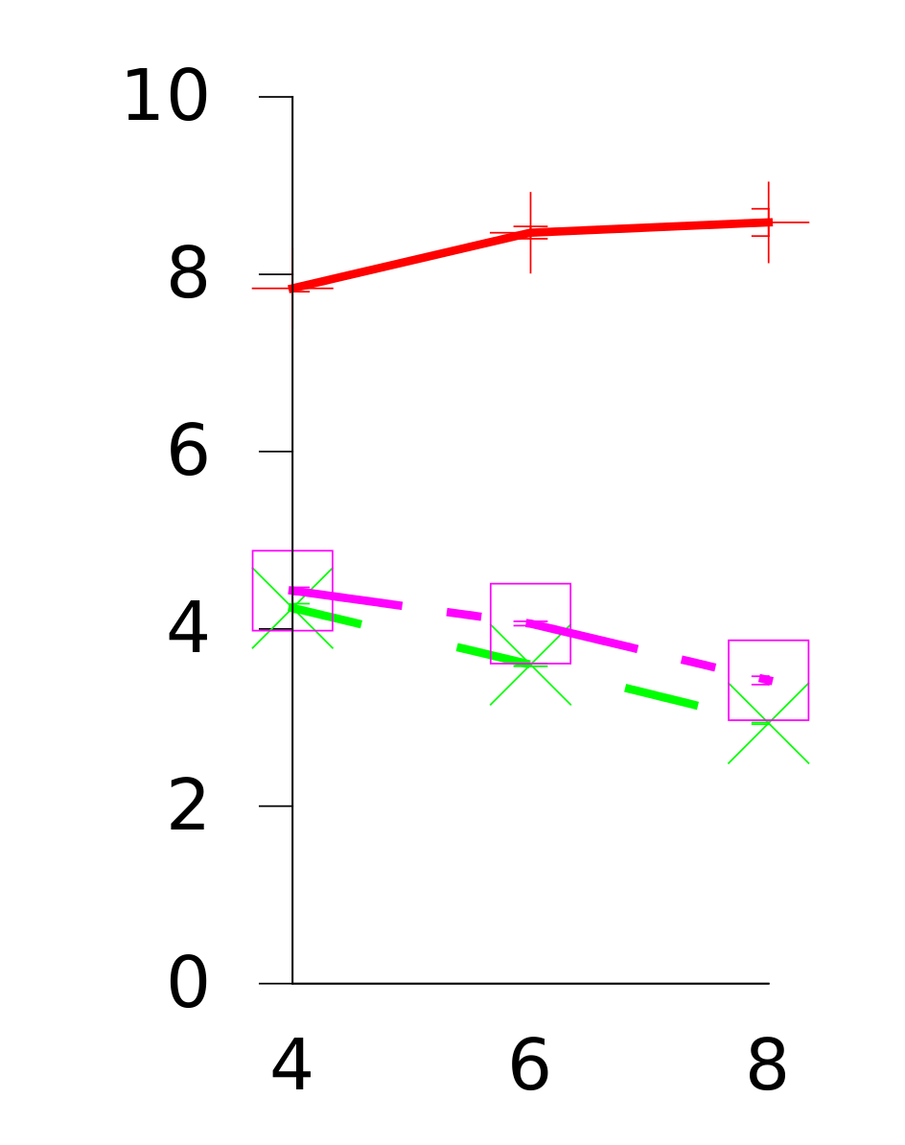
GC Throughput (GB collected per second)
Improved PS
NAPS
NumaGiC
Spark
Neo4j
SpecJBB13
SpecJBB05
on
Amd48
GC Throughput
Heap Sizes
Notes:
In this slide u see the gc throughput in case of the 4 application, when ran on amd 48-core machine
X-axis is different heap sizes

Slide 31
GC Throughput (GB collected per second)
Improved PS
NAPS
NumaGiC
Spark
Neo4j
SpecJBB13
SpecJBB05
5.4X
on
Amd48
GC Throughput
2.9X
Heap Sizes
NumaGiC multiplies GC performance up to 5.4X
Notes:
As you can see that we substantially improve the GC throughput as compared to both Improved PS, and NAPS.
On average, we roughly multiple the GC performance by 2

Slide 32
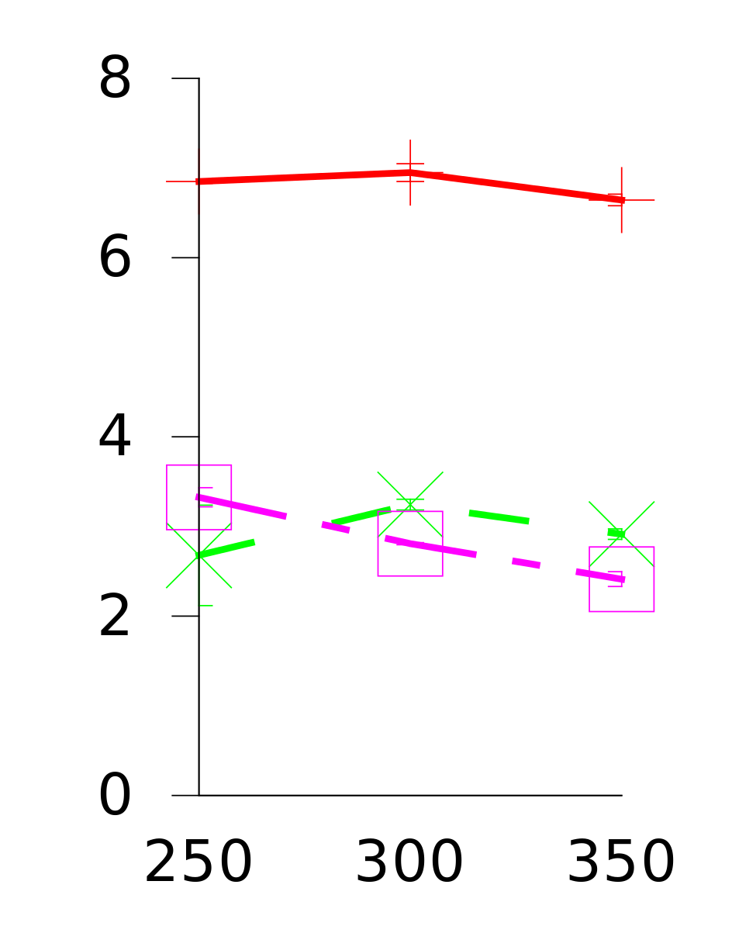
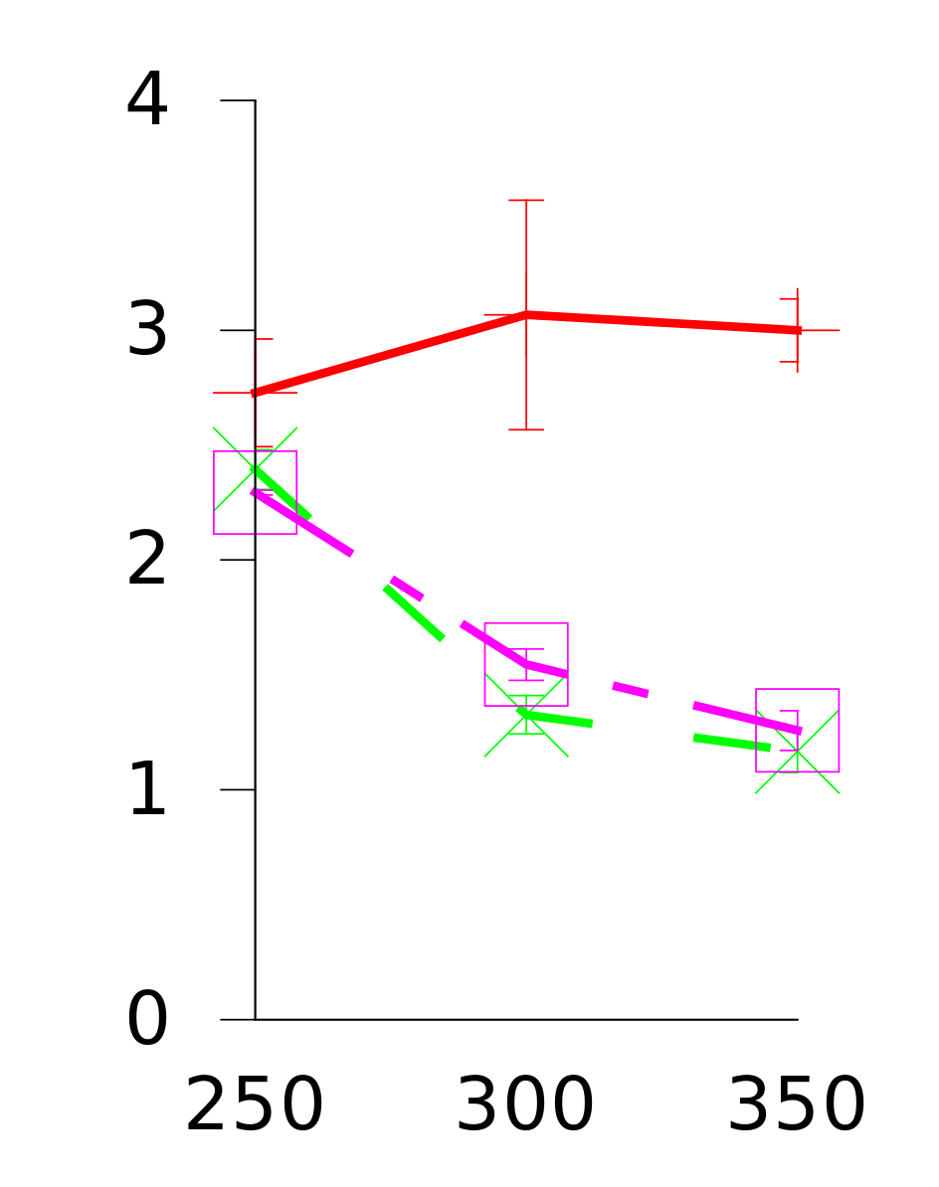
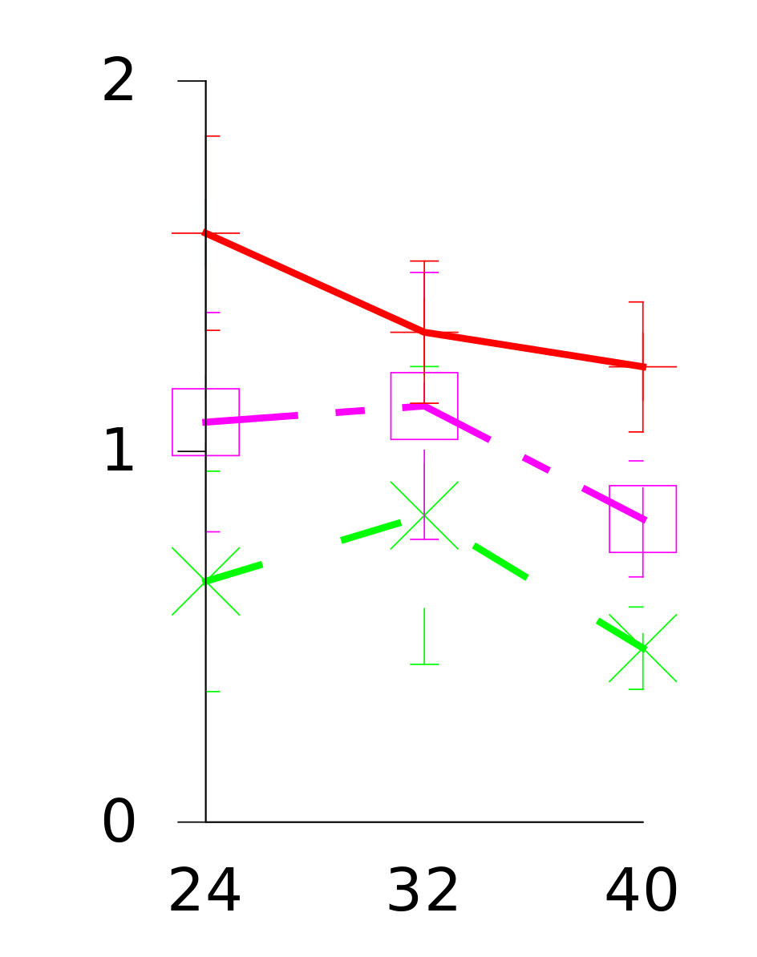
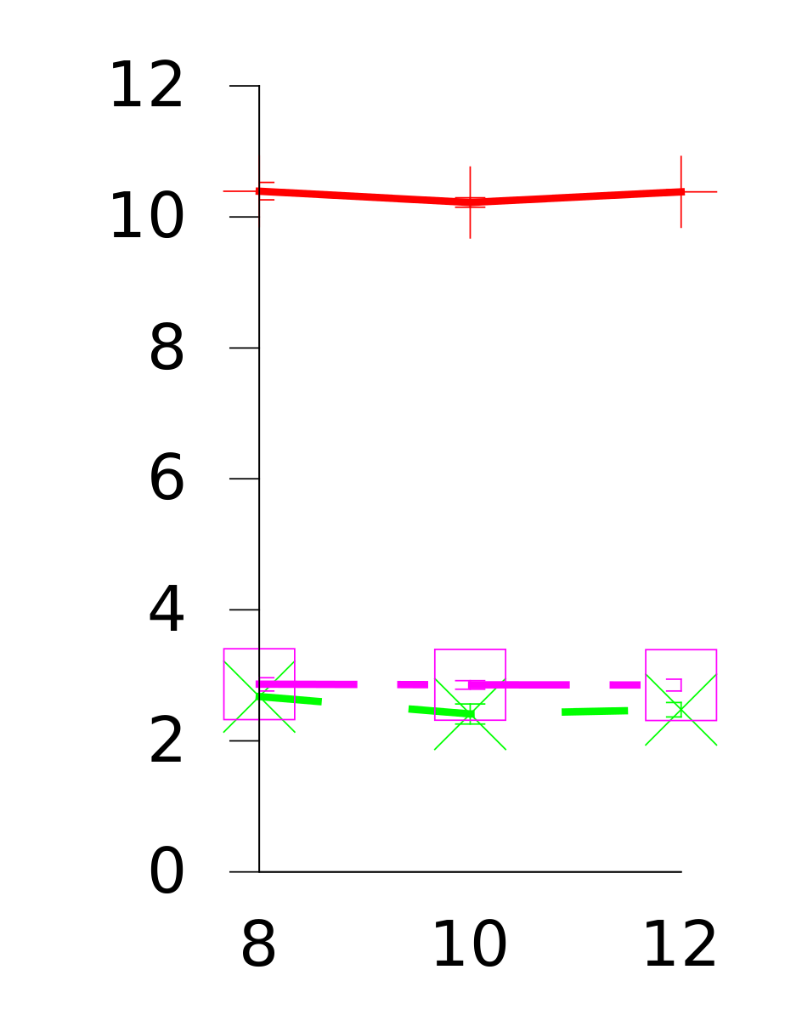
GC Throughput (GB collected per second)
Spark
Neo4j
SpecJBB13
SpecJBB05
on
Amd48
GC Throughput
on
Intel80
3.6X
Heap Sizes
Notes:
And the improvement in GC performance is not limited to the amd machine. We also perform outperform on the intel machine.
This shows that our design is not customized for a specific architecture

Slide 33
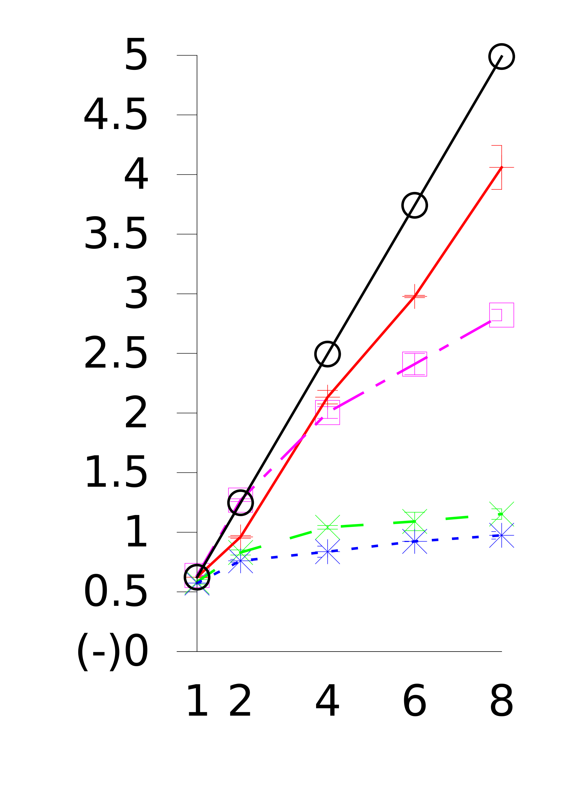
GC Throughput Scalability
Ideal Scalability
NumaGiC
GC Throughput
NAPS
Improved PS
Baseline PS
Spark on Amd48 with a
smaller dataset of 40GB
# of nodes
Notes:
Moving on to GC throughput scalability. When comparing numagic with all the existing GCs, it scales substantially better than others.
In the end: “Let us see how it translates to application performance”. After all we claimed in the beginning that GC performance improvement must have direct impact on the application performance.

Slide 34
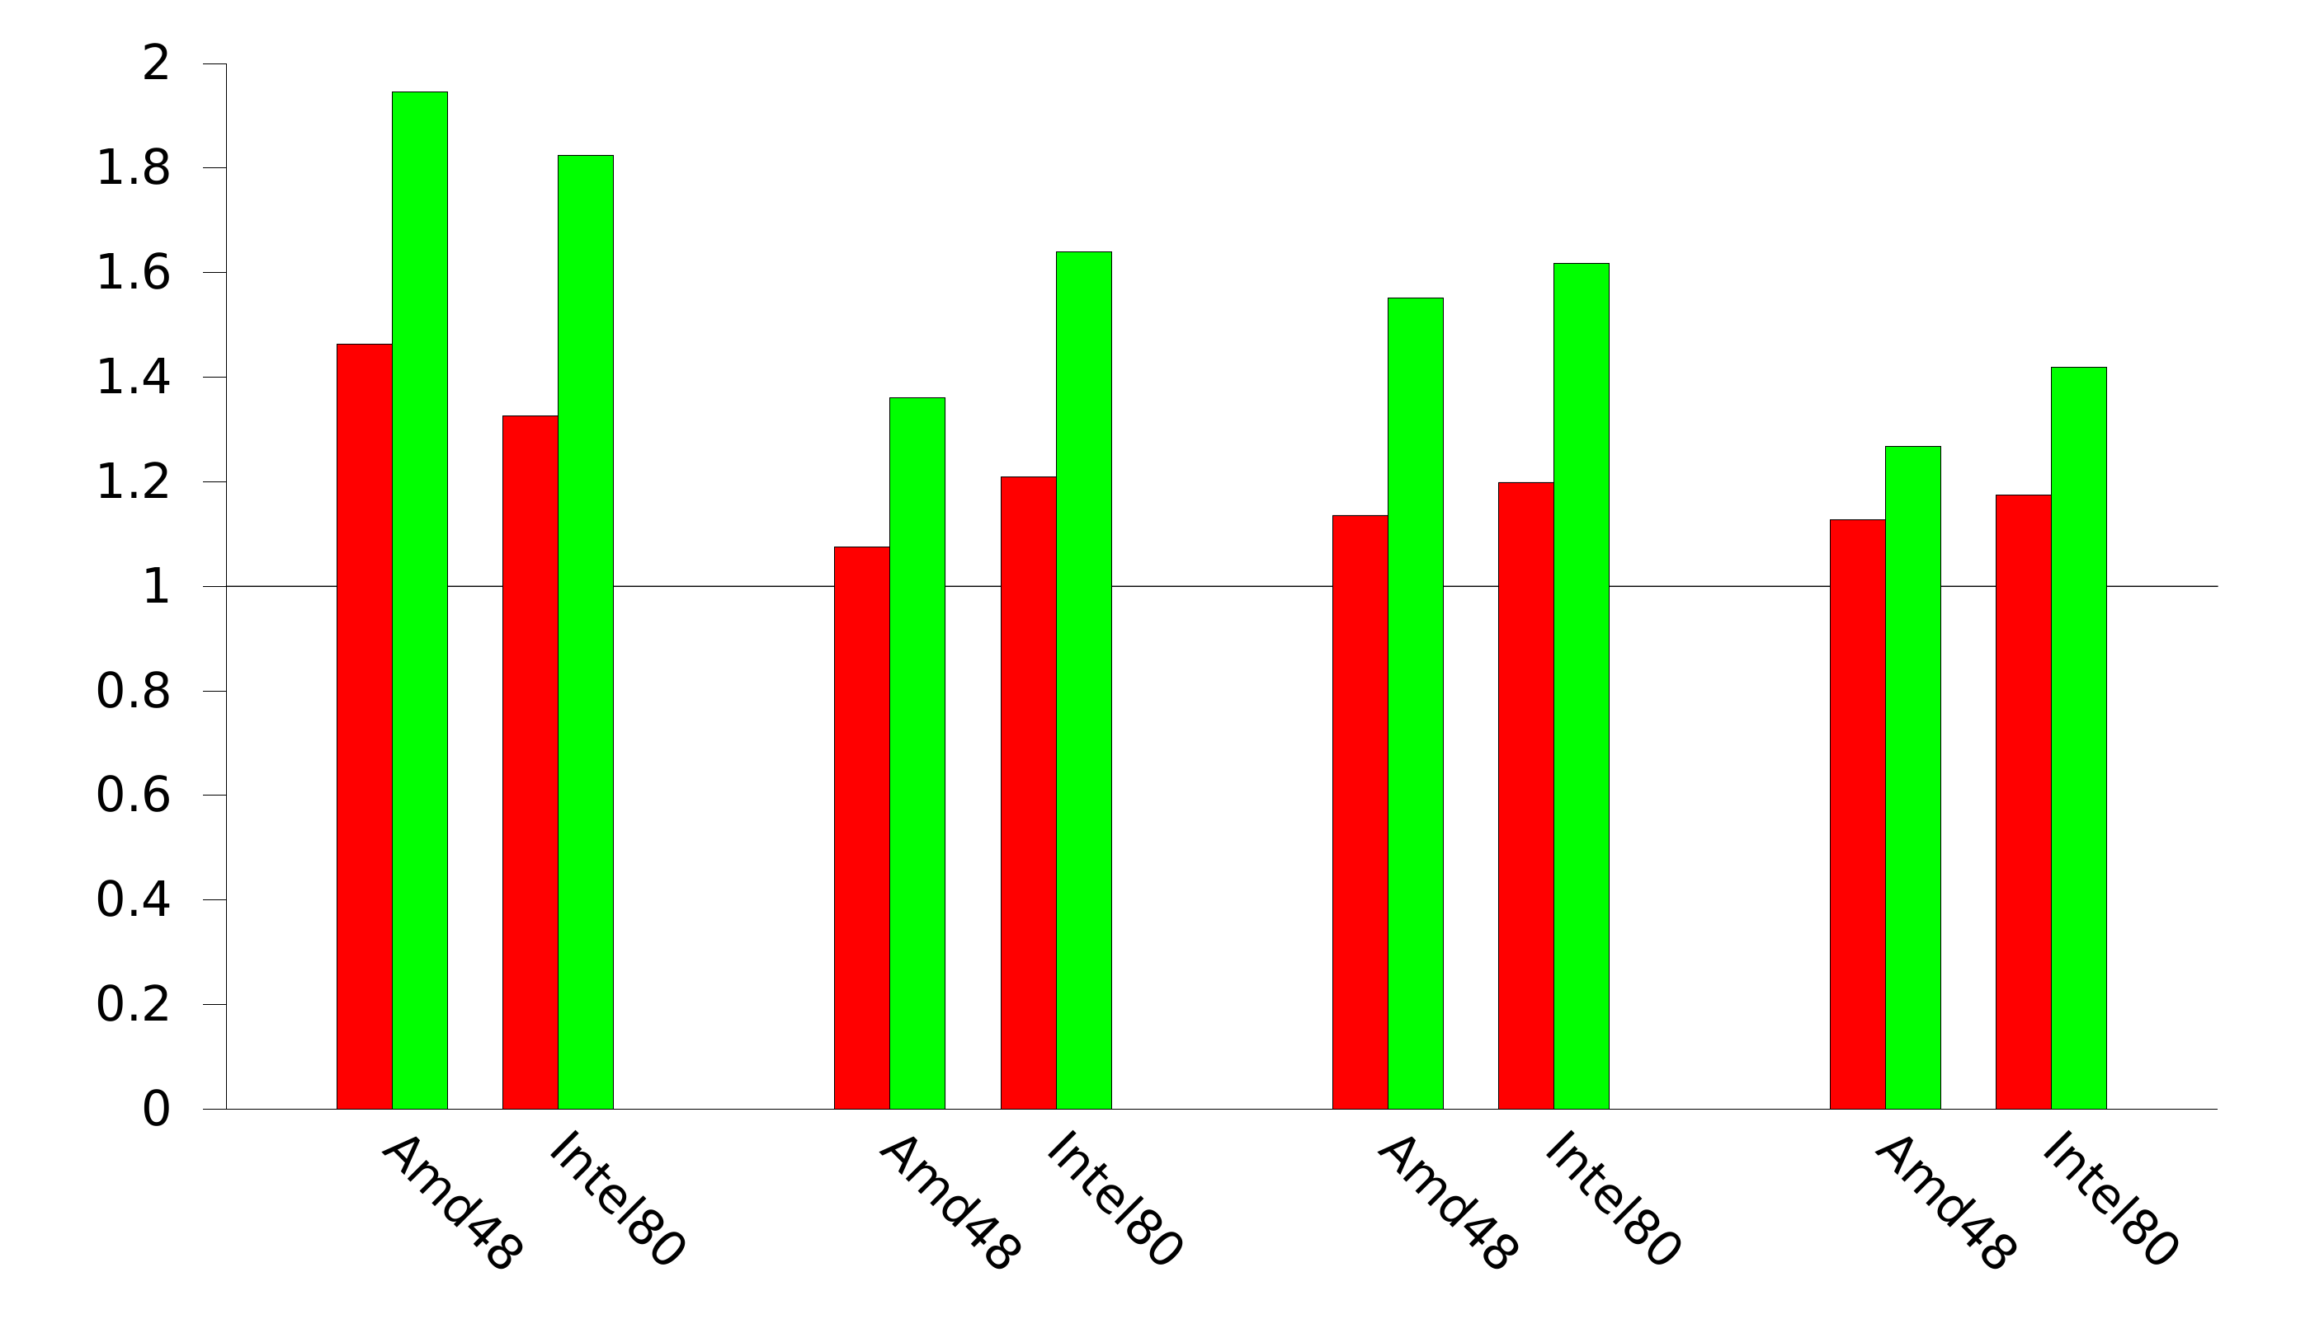


Application speedup
94%
82%
64%
61%
55%
42%
36%
27%
Speedup relative
to Improved PS
Spark
Neo4j
SpecJBB13
SpecJBB05
NAPS
NumaGiC
Notes:
And, it is indeed true. In fact, we make substantial impact on app performance
We can see in this figure that numagic ensures that the application speeds up up-to 94% as compared when other GC are used. This translates to application taking almost half of the total time in completion.
Even the smallest improvement, in case of SPECjbb2005, is around 27% as compared to PS.

Slide 35
Application speedup
37%
33%
35%
37%
37%
21%
26%
12%
Speedup relative
to Improved PS
Spark
Neo4j
SpecJBB13
SpecJBB05
NAPS
NumaGiC
Notes:
Furthermore, numagic actually makes substantial improvement even when compared to NAPS. The improvement is up to 37%

Slide 36
Conclusion
Performance of data-intensive apps relies on GC performance
Memory access locality has huge effect on GC performance
Enforcing locality can be detrimental for parallelism in GCs
Future work: NUMA-aware concurrent GCs

Slide 37
Conclusion
Performance of data-intensive apps relies on GC performance
Memory access locality has huge effect on GC performance
Enforcing locality can be detrimental for parallelism in GCs
Future work: NUMA-aware concurrent GCs
Thank You ☺

Slide 38
Large multicores provide this power
But scalability is hard to achieve
because software stack was not designed for
Application
Data analytic
Middleware
Hadoop, Spark,
Neo4j, Cassandra…
Language runtime
JVM, CLI, Python, R…
Operating system
Linux, Windows…
Hypervisor
Xen, VMWare…
I/O controllers
Cores
Memory Banks

Slide 39
Large multicores provide this power
But scalability is hard to achieve
because software stack was not designed for
Application
Data analytic
Middleware
Hadoop, Spark,
Neo4j, Cassandra…
Language runtime
JVM, CLI, Python, R…
Operating system
Linux, Windows…
Do not consider hypervisors in this talk:
Software stack is already complex
and hard to analyze!
Hypervisor
I/O controllers
Cores
Memory Banks

