Slide 1




Write Fast, Read in the Past:
Causal Consistency for Client-side Apps with SwiftCloud
Presented by Marek Zawirski
Inria / UPMC-LIP6, Paris
(now at Google, Zürich)
Marek Zawirski, Nuno Preguiça, Sérgio Duarte,
Annette Bieniusa, Valter Balegas, Marc Shapiro

Slide 2




Challenge: Database Access for Client-side Apps
App
App
App
App
Notes:
Geo-replication across DCs => ~HA and fast reads
Asynchronous replication => fast updates with limitted consistency, often acceptable (NoSQL crowd)
CLIENT NEVER WAITING/BLOCKED

Slide 3
Challenge: Database Access for Client-side Apps
App
App
A
P
I
A
P
I
App
App
Limited boundaries of server-side database guarantees
Notes:
Geo-replication across DCs => ~HA and fast reads
Asynchronous replication => fast updates with limitted consistency, often acceptable (NoSQL crowd)
CLIENT NEVER WAITING/BLOCKED

Slide 4
Challenge: Database Access for Client-side Apps
App
App
A
P
I
A
P
I
App
App
Limited boundaries of server-side database guarantees
⇒ ad-hoc on the client-side
Notes:
Geo-replication across DCs => ~HA and fast reads
Asynchronous replication => fast updates with limitted consistency, often acceptable (NoSQL crowd)
CLIENT NEVER WAITING/BLOCKED

Slide 5
Challenge: Database Access for Client-side Apps
A
P
I
App
App
A
P
I
App
A
P
I
A
P
I
App
Extended boundaries with SwiftCloud
Notes:
Geo-replication across DCs => ~HA and fast reads
Asynchronous replication => fast updates with limitted consistency, often acceptable (NoSQL crowd)
CLIENT NEVER WAITING/BLOCKED

Slide 6
Challenge: Database Access for Client-side Apps
A
P
I
App
App
A
P
I
App
A
P
I
A
P
I
App
Extended boundaries with SwiftCloud
Consistent, available and convergent data access
Scalability with #objects and #clients
Fault-tolerance
Notes:
Geo-replication across DCs => ~HA and fast reads
Asynchronous replication => fast updates with limitted consistency, often acceptable (NoSQL crowd)
CLIENT NEVER WAITING/BLOCKED

Slide 7


Stronger than Eventual: Causal Consistency
Default on client-side: eventual consistency ⇒ anomalies
bob_posts.add(“don’t think of visiting Vancouver…”)
client order
bob_posts.add(“… just do it! YOLO”)
read
replies.add(“Alice: totally ☺”)
Notes:
Geo-replication across DCs => ~HA and fast reads
Asynchronous replication => fast updates with limitted consistency, often acceptable (NoSQL crowd)
CLIENT NEVER WAITING/BLOCKED

Slide 8
Stronger than Eventual: Causal Consistency
Default on client-side: eventual consistency ⇒ anomalies
bob_posts.add(“don’t think of visiting Vancouver…”)
client order
bob_posts.add(“… just do it! YOLO”)
read
read
read
replies.add(“Alice: totally ☺”)
Notes:
Geo-replication across DCs => ~HA and fast reads
Asynchronous replication => fast updates with limitted consistency, often acceptable (NoSQL crowd)
CLIENT NEVER WAITING/BLOCKED

Slide 9
Stronger than Eventual: Causal Consistency
Default on client-side: eventual consistency ⇒ anomalies
bob_posts.add(“don’t think of visiting Vancouver…”)
client order
bob_posts.add(“… just do it! YOLO”)
read
read
ordering anomaly
read
replies.add(“Alice: totally ☺”)
!?!
Notes:
Geo-replication across DCs => ~HA and fast reads
Asynchronous replication => fast updates with limitted consistency, often acceptable (NoSQL crowd)
CLIENT NEVER WAITING/BLOCKED

Slide 10
Stronger than Eventual: Causal Consistency
Default on client-side: eventual consistency ⇒ anomalies
bob_posts.add(“don’t think of visiting Vancouver…”)
client order
bob_posts.add(“… just do it! YOLO”)
read
read
read
replies.add(“Alice: totally ☺”)
Causal consistency: reads from causally-closed snapshot
Notes:
Geo-replication across DCs => ~HA and fast reads
Asynchronous replication => fast updates with limitted consistency, often acceptable (NoSQL crowd)
CLIENT NEVER WAITING/BLOCKED

Slide 11
Convergent Causal Consistency: No Lost Updates
bob_posts.add(“don’t think of visiting Vancouver…”)
client order
bob_posts.add(“… just do it! YOLO”)
read
read
replies.add(“Alice: totally ☺”)
replies.add( “Eve: Bob ♥”)
read
read
replies: ???
Notes:
Geo-replication across DCs => ~HA and fast reads
Asynchronous replication => fast updates with limitted consistency, often acceptable (NoSQL crowd)
CLIENT NEVER WAITING/BLOCKED

Slide 12
Convergent Causal Consistency: No Lost Updates
bob_posts.add(“don’t think of visiting Vancouver…”)
client order
bob_posts.add(“… just do it! YOLO”)
read
read
replies.add(“Alice: totally ☺”)
replies.add( “Eve: Bob ♥”)
read
read
replies: {“Alice: totally ☺”, “Eve: Bob ♥”}
High-level convergent objects^{[CRDTs]} resolve concurrency
Notes:
Geo-replication across DCs => ~HA and fast reads
Asynchronous replication => fast updates with limitted consistency, often acceptable (NoSQL crowd)
CLIENT NEVER WAITING/BLOCKED

Slide 13
Challenge: Causal Consistency with Partial Replicas
^{[PRACTI, NSDI’06]}
objA.op
objB.op
objC.op
objB.op
Notes:
Geo-replication across DCs => ~HA and fast reads
Asynchronous replication => fast updates with limitted consistency, often acceptable (NoSQL crowd)
CLIENT NEVER WAITING/BLOCKED

Slide 14
Challenge: Causal Consistency with Partial Replicas
^{[PRACTI, NSDI’06]}
objA.op
current state
objB.op
objC.op
objA
objB
objB.op
Notes:
Geo-replication across DCs => ~HA and fast reads
Asynchronous replication => fast updates with limitted consistency, often acceptable (NoSQL crowd)
CLIENT NEVER WAITING/BLOCKED

Slide 15
Challenge: Causal Consistency with Partial Replicas
^{[PRACTI, NSDI’06]}
objA.op
objB.op
objC.op
objA
objB
objB.op
objB
objC
Notes:
Geo-replication across DCs => ~HA and fast reads
Asynchronous replication => fast updates with limitted consistency, often acceptable (NoSQL crowd)
CLIENT NEVER WAITING/BLOCKED

Slide 16
Challenge: Causal Consistency with Partial Replicas
^{[PRACTI, NSDI’06]}
objA.op
objB.op
objC.op
objA
objB
objB.op
objA
objC
objB
objC
Notes:
Geo-replication across DCs => ~HA and fast reads
Asynchronous replication => fast updates with limitted consistency, often acceptable (NoSQL crowd)
CLIENT NEVER WAITING/BLOCKED

Slide 17
Challenge: Causal Consistency with Partial Replicas
^{[PRACTI, NSDI’06]}
objA.op
objB.op
objC.op
objA
objB
objB.op
objA
objC
objB
objC
Notes:
Geo-replication across DCs => ~HA and fast reads
Asynchronous replication => fast updates with limitted consistency, often acceptable (NoSQL crowd)
CLIENT NEVER WAITING/BLOCKED

Slide 18
Challenge: Causal Consistency with Partial Replicas
^{[PRACTI, NSDI’06]}
objA.op
objB.op
objC.op
objA
objB
objB.op
objA
objC
objB.op
objB
objC
dependencies
objA.op
objB.op
objC.op
Notes:
Geo-replication across DCs => ~HA and fast reads
Asynchronous replication => fast updates with limitted consistency, often acceptable (NoSQL crowd)
CLIENT NEVER WAITING/BLOCKED

Slide 19
Challenge: Causal Consistency with Partial Replicas
^{[PRACTI, NSDI’06]}
objA.op
objB.op
objC.op
objA
objB
objB.op
objA
objC
objB.op
objB
objC
dependencies
1 | 0 | 2
Inherent trade-offs in the general case:
scalability vs. availability vs. fault-tolerance
objB.op
Notes:
Geo-replication across DCs => ~HA and fast reads
Asynchronous replication => fast updates with limitted consistency, often acceptable (NoSQL crowd)
CLIENT NEVER WAITING/BLOCKED

Slide 20
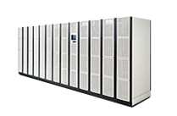



Approach: Cloud-backed Partial Replicas
Data Center full replicas:
Provide consistent view Assign small metadata
geo-replication
4 | 9
DC
DC
Notes:
Geo-replication across DCs => ~HA and fast reads
Asynchronous replication => fast updates with limitted consistency, often acceptable (NoSQL crowd)
CLIENT NEVER WAITING/BLOCKED

Slide 21
Approach: Cloud-backed Partial Replicas
Data Center full replicas:
Provide consistent view Assign small metadata
geo-replication
4 | 9
DC
DC
cache
log
App
Notes:
Geo-replication across DCs => ~HA and fast reads
Asynchronous replication => fast updates with limitted consistency, often acceptable (NoSQL crowd)
CLIENT NEVER WAITING/BLOCKED

Slide 22
Approach: Cloud-backed Partial Replicas
Data Center full replicas:
Provide consistent view Assign small metadata
geo-replication
4 | 9
DC
DC
cache
log
App
update
Notes:
Geo-replication across DCs => ~HA and fast reads
Asynchronous replication => fast updates with limitted consistency, often acceptable (NoSQL crowd)
CLIENT NEVER WAITING/BLOCKED

Slide 23

Approach: Cloud-backed Partial Replicas
Data Center full replicas:
Provide consistent view Assign small metadata
geo-replication
4 | 9
DC
DC
5
4 | 9
cache
log
App
update
Notes:
Geo-replication across DCs => ~HA and fast reads
Asynchronous replication => fast updates with limitted consistency, often acceptable (NoSQL crowd)
CLIENT NEVER WAITING/BLOCKED

Slide 24
Approach: Cloud-backed Partial Replicas
Data Center full replicas:
Provide consistent view Assign small metadata
geo-replication
4 | 9
DC
DC
cache
log
App
read
Client reads: cached fragment of cloud version ∪ own log
High availability Consistency w/read-your-writes
Notes:
Geo-replication across DCs => ~HA and fast reads
Asynchronous replication => fast updates with limitted consistency, often acceptable (NoSQL crowd)
CLIENT NEVER WAITING/BLOCKED

Slide 25

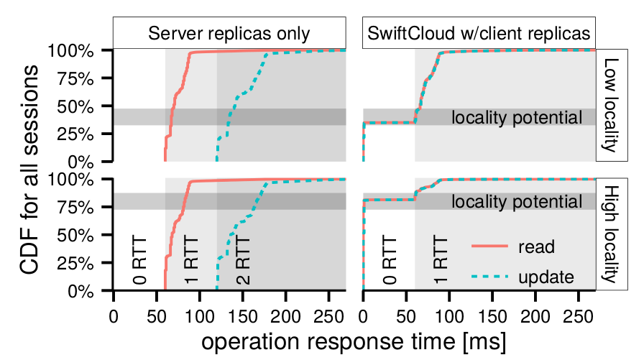
Potential of Cloud-backed Client Replicas
CDF for 1000 clients
Response time of operation [ms]
Setup: DCs in 3 AWS EC2 regions, YCSB workload, cache=256 objects
Notes:
Geo-replication across DCs => ~HA and fast reads
Asynchronous replication => fast updates with limitted consistency, often acceptable (NoSQL crowd)
CLIENT NEVER WAITING/BLOCKED

Slide 26
Potential of Cloud-backed Client Replicas
CDF for 1000 clients
Response time of operation [ms]
Objects in the cache ⇒ immediate, consistent response
Setup: DCs in 3 AWS EC2 regions, YCSB workload, cache=256 objects
Notes:
Geo-replication across DCs => ~HA and fast reads
Asynchronous replication => fast updates with limitted consistency, often acceptable (NoSQL crowd)
CLIENT NEVER WAITING/BLOCKED

Slide 27
Challenge for the Cloud Approach: Safe DC Failover
log
cache
Notes:
Geo-replication across DCs => ~HA and fast reads
Asynchronous replication => fast updates with limitted consistency, often acceptable (NoSQL crowd)
CLIENT NEVER WAITING/BLOCKED

Slide 28
Challenge for the Cloud Approach: Safe DC Failover
log
cache
risky read
Notes:
Geo-replication across DCs => ~HA and fast reads
Asynchronous replication => fast updates with limitted consistency, often acceptable (NoSQL crowd)
CLIENT NEVER WAITING/BLOCKED

Slide 29
Challenge for the Cloud Approach: Safe DC Failover
operations with
risky dependencies
log
cache
risky read
Notes:
Geo-replication across DCs => ~HA and fast reads
Asynchronous replication => fast updates with limitted consistency, often acceptable (NoSQL crowd)
CLIENT NEVER WAITING/BLOCKED

Slide 30

Challenge for the Cloud Approach: Safe DC Failover
operations with
risky dependencies
log
cache
risky read
new DC in incompatible state
Notes:
Geo-replication across DCs => ~HA and fast reads
Asynchronous replication => fast updates with limitted consistency, often acceptable (NoSQL crowd)
CLIENT NEVER WAITING/BLOCKED

Slide 31
Supporting Failover by Conservative Reads
log
cache
K=2
Foreign updates: read version replicated in K > 1 DCs
Own writes: read from the log, recover to a new DC
Notes:
Geo-replication across DCs => ~HA and fast reads
Asynchronous replication => fast updates with limitted consistency, often acceptable (NoSQL crowd)
CLIENT NEVER WAITING/BLOCKED

Slide 32
Supporting Failover by Conservative Reads
log
cache
K=2
conservative read
Foreign updates: read version replicated in K > 1 DCs
Own writes: read from the log, recover to a new DC
Notes:
Geo-replication across DCs => ~HA and fast reads
Asynchronous replication => fast updates with limitted consistency, often acceptable (NoSQL crowd)
CLIENT NEVER WAITING/BLOCKED

Slide 33
Supporting Failover by Conservative Reads
log
cache
K=2
new DC in compatible state
Foreign updates: read version replicated in K > 1 DCs
Own writes: read from the log, recover to a new DC
Notes:
Geo-replication across DCs => ~HA and fast reads
Asynchronous replication => fast updates with limitted consistency, often acceptable (NoSQL crowd)
CLIENT NEVER WAITING/BLOCKED

Slide 34
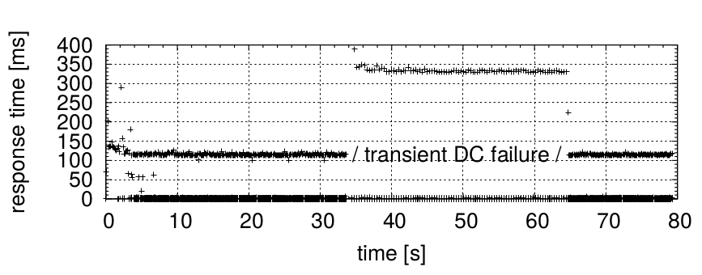





Experiment: Injection of Short DC Disconnection
response time [ms]
Notes:
Geo-replication across DCs => ~HA and fast reads
Asynchronous replication => fast updates with limitted consistency, often acceptable (NoSQL crowd)
CLIENT NEVER WAITING/BLOCKED

Slide 35
Experiment: Injection of Short DC Disconnection
response time [ms]
remote reads
fast conservative reads
Notes:
Geo-replication across DCs => ~HA and fast reads
Asynchronous replication => fast updates with limitted consistency, often acceptable (NoSQL crowd)
CLIENT NEVER WAITING/BLOCKED

Slide 36
Experiment: Injection of Short DC Disconnection
remote ops: smooth failover
response time [ms]
remote reads
fast conservative reads
… unaffected …
Notes:
Geo-replication across DCs => ~HA and fast reads
Asynchronous replication => fast updates with limitted consistency, often acceptable (NoSQL crowd)
CLIENT NEVER WAITING/BLOCKED

Slide 37
Experiment: Injection of Short DC Disconnection
remote ops: smooth failover
response time [ms]
remote reads
fast conservative reads
… unaffected …
Trade-off controlled by K: staleness vs. availability
  Staleness negligible in most K=2 setups, < 1% reads
  In cherry-picked unfavorable setup, 1.0–2.5% reads
Notes:
Geo-replication across DCs => ~HA and fast reads
Asynchronous replication => fast updates with limitted consistency, often acceptable (NoSQL crowd)
CLIENT NEVER WAITING/BLOCKED

Slide 38

Challenge for the Cloud Approach: Protocol Retries
x=0
x=0
x=0
x.inc()
(x=1)
inc()
inc()
x=1
4
4
time
Notes:
Geo-replication across DCs => ~HA and fast reads
Asynchronous replication => fast updates with limitted consistency, often acceptable (NoSQL crowd)
CLIENT NEVER WAITING/BLOCKED

Slide 39

Challenge for the Cloud Approach: Protocol Retries
x=0
x=0
x=0
x.inc()
(x=1)
inc()
inc()
x=1
4
4
inc()
inc()
x=1
3
Notes:
Geo-replication across DCs => ~HA and fast reads
Asynchronous replication => fast updates with limitted consistency, often acceptable (NoSQL crowd)
CLIENT NEVER WAITING/BLOCKED

Slide 40
Challenge for the Cloud Approach: Protocol Retries
x=0
x=0
x=0
x.inc()
(x=1)
inc()
inc()
x=1
4
4
inc()
3
inc()
x=1
3
Notes:
Geo-replication across DCs => ~HA and fast reads
Asynchronous replication => fast updates with limitted consistency, often acceptable (NoSQL crowd)
CLIENT NEVER WAITING/BLOCKED

Slide 41
Challenge for the Cloud Approach: Protocol Retries
x=0
x=0
x=0
x.inc()
(x=1)
inc()
inc()
x=1
4
4
inc()
geo-replication
3
inc()
x=1
3
inc()
inc()
x=2
4
3
Notes:
Geo-replication across DCs => ~HA and fast reads
Asynchronous replication => fast updates with limitted consistency, often acceptable (NoSQL crowd)
CLIENT NEVER WAITING/BLOCKED

Slide 42
Challenge for the Cloud Approach: Protocol Retries
x=0
x=0
x=0
x.inc()
(x=1)
inc()
inc()
x=1
4
4
inc()
geo-replication
3
inc()
x=1
3
inc()
inc()
x=2
4
3
duplicate delivery!
Notes:
Geo-replication across DCs => ~HA and fast reads
Asynchronous replication => fast updates with limitted consistency, often acceptable (NoSQL crowd)
CLIENT NEVER WAITING/BLOCKED

Slide 43
Safe Retries with Decoupled Metadata
x=0
x=0
x=0
x.inc()
(x=1)
1
inc()
1
x=1
4
inc()
4
1
geo-replication
inc()
~
1
x=1
1
3
inc()
3
3
1
x=1
~
inc()
4
3
1
4
safe: ≤ 1 delivery
Solution: client-assigned timestamps for safety
+ 1..N DC timestamps for efficient summary
Notes:
Geo-replication across DCs => ~HA and fast reads
Asynchronous replication => fast updates with limitted consistency, often acceptable (NoSQL crowd)
CLIENT NEVER WAITING/BLOCKED

Slide 44
Safe Retries with Decoupled Metadata
x=0
x=0
x=0
x.inc()
(x=1)
1
inc()
1
x=1
4
inc()
4
1
geo-replication
inc()
~
1
x=1
1
3
inc()
3
3
1
x=1
~
inc()
4
3
1
4
safe: ≤ 1 delivery
Solution: client-assigned timestamps for safety
+ 1..N DC timestamps for efficient summary
Notes:
Geo-replication across DCs => ~HA and fast reads
Asynchronous replication => fast updates with limitted consistency, often acceptable (NoSQL crowd)
CLIENT NEVER WAITING/BLOCKED

Slide 45
Safe Retries with Decoupled Metadata
x=0
x=0
x=0
x.inc()
(x=1)
1
inc()
1
x=1
4
inc()
4
1
geo-replication
inc()
~
1
x=1
1
3
inc()
3
3
1
x=1
~
inc()
4
3
1
4
safe: ≤ 1 delivery
Solution: client-assigned timestamps for safety
+ 1..N DC timestamps for efficient summary
Extension: log pruning independent of client availability
Notes:
Geo-replication across DCs => ~HA and fast reads
Asynchronous replication => fast updates with limitted consistency, often acceptable (NoSQL crowd)
CLIENT NEVER WAITING/BLOCKED

Slide 46
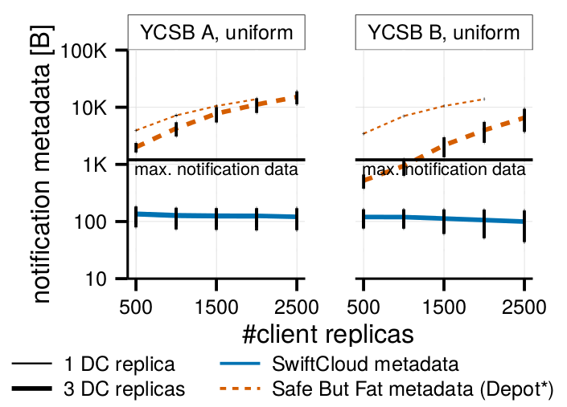
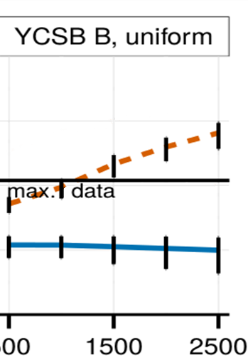
Experiment: Size of Metadata on Client-DC Link
Client-assigned vectors^{[PRACTI, NSDI’06]}:
unbounded overhead
1K
100
metadata / update [B]
SwiftCloud’s decoupled metadata:
const size
10
1
# client replicas
Setup: 3DCs, YCSB B uniform workload
Notes:
Geo-replication across DCs => ~HA and fast reads
Asynchronous replication => fast updates with limitted consistency, often acceptable (NoSQL crowd)
CLIENT NEVER WAITING/BLOCKED

Slide 47
Summary
  SwiftCloud provides client-side apps:
Consistent, available and convergent object database
Scalability: full replicas at DC back partial at client
⇒ small causality metadata (< 15B/update)
Fast failover thanks to conservative reads (< 1% stale)
Safe retry of interrupted transfer and safe log pruning thanks to decoupled metadata
  Research prototype at github.com/SyncFree/SwiftCloud
Notes:
Geo-replication across DCs => ~HA and fast reads
Asynchronous replication => fast updates with limitted consistency, often acceptable (NoSQL crowd)
CLIENT NEVER WAITING/BLOCKED

Slide 48
SwiftCloud compared to “Lazy Replication”
Assume client-side application logic
Describe causal consistency support
Support communication with multiple servers
Use decoupled metadata
DB = RDT objects + global transactions
Supports partial client replicas => fast reads and read-your-writes
K-stability-driven trade-off
GC independent of clients
Monolithic DB
No client-side replicas
Stability discussion
Physical-clock-driven GC
More consistency choices
Notes:
Geo-replication across DCs => ~HA and fast reads
Asynchronous replication => fast updates with limitted consistency, often acceptable (NoSQL crowd)
CLIENT NEVER WAITING/BLOCKED

Slide 49
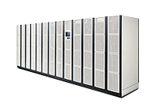
Challenge for the Cloud Approach: Protocol Retries
inc
4
log
inc()
cache
inc()
3
inc
4
inc
3
duplicate delivery!
Notes:
Geo-replication across DCs => ~HA and fast reads
Asynchronous replication => fast updates with limitted consistency, often acceptable (NoSQL crowd)
CLIENT NEVER WAITING/BLOCKED

Slide 50
Safe Retries with Decoupled Metadata
1
inc
4
1
log
inc()
cache
1
inc()
3
4
1
inc
3
4
safe: ≤ 1 delivery
Solution: client-assigned timestamps for safety
+ 1..N DC timestamps for efficient summary
Notes:
Geo-replication across DCs => ~HA and fast reads
Asynchronous replication => fast updates with limitted consistency, often acceptable (NoSQL crowd)
CLIENT NEVER WAITING/BLOCKED

Slide 51
Safe Retries with Decoupled Metadata
1
inc
4
1
log
inc()
cache
1
inc()
3
4
1
inc
3
4
safe: ≤ 1 delivery
Solution: client-assigned timestamps for safety
+ 1..N DC timestamps for efficient summary
Notes:
Geo-replication across DCs => ~HA and fast reads
Asynchronous replication => fast updates with limitted consistency, often acceptable (NoSQL crowd)
CLIENT NEVER WAITING/BLOCKED

Slide 52
Safe Retries with Decoupled Metadata
1
inc
4
1
log
inc()
cache
1
inc()
3
4
1
inc
3
4
safe: ≤ 1 delivery
Solution: client-assigned timestamps for safety
+ 1..N DC timestamps for efficient summary
Extension: log pruning independent of client availability
Notes:
Geo-replication across DCs => ~HA and fast reads
Asynchronous replication => fast updates with limitted consistency, often acceptable (NoSQL crowd)
CLIENT NEVER WAITING/BLOCKED

